Slide 1
Week 10 Update
AA 290 / AA 279D
12/3/2019

Slide 2
Contents
Extended maneuver planning and moding
Now have multiple waypoints
Attempting Vbar maneuvers

Slide 3
Overall Mission
Start above and ahead
Come to intermediate orbit, 0.5 km rbar
Come down to 0 km rbar
Vbar maneuvers to rendezvous → moding is set up but calculating burns not done
#1
#2
#3

Slide 4
Future Work
Finish Vbar maneuvers
Implementing a burn to raise da, and then recirculaize to drift and then once close enough will use roe calculated burns to complete rendezvou

Slide 5
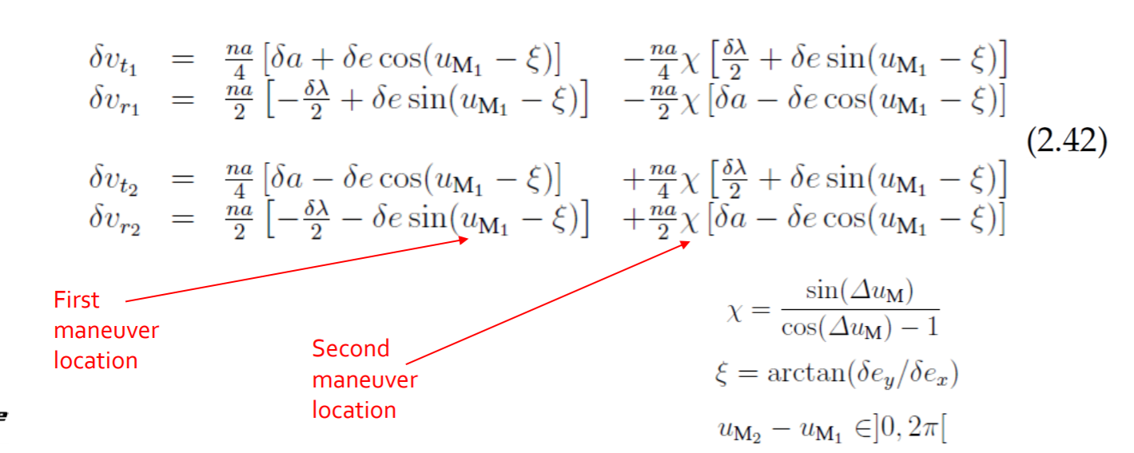
Maneuver Planning
Using these for Vbar manuevers

